Slide 1

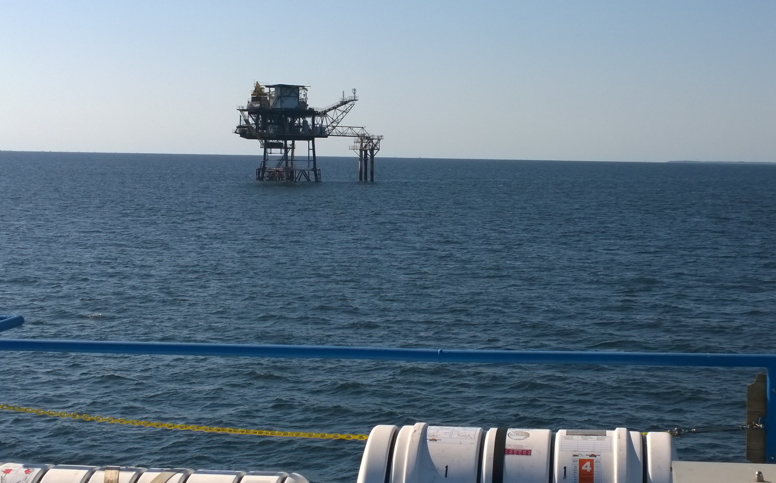



Goals, expectations, logistics
2nd International Workshop
Katherine Romanak, Tip Meckel (Gulf Coast Carbon Center) and
Tim Dixon (IEAGHG and BEG Honorary Senior Research Fellow)
19-20 June, 2017
Lamar University
Beaumont, Texas, USA

Slide 2
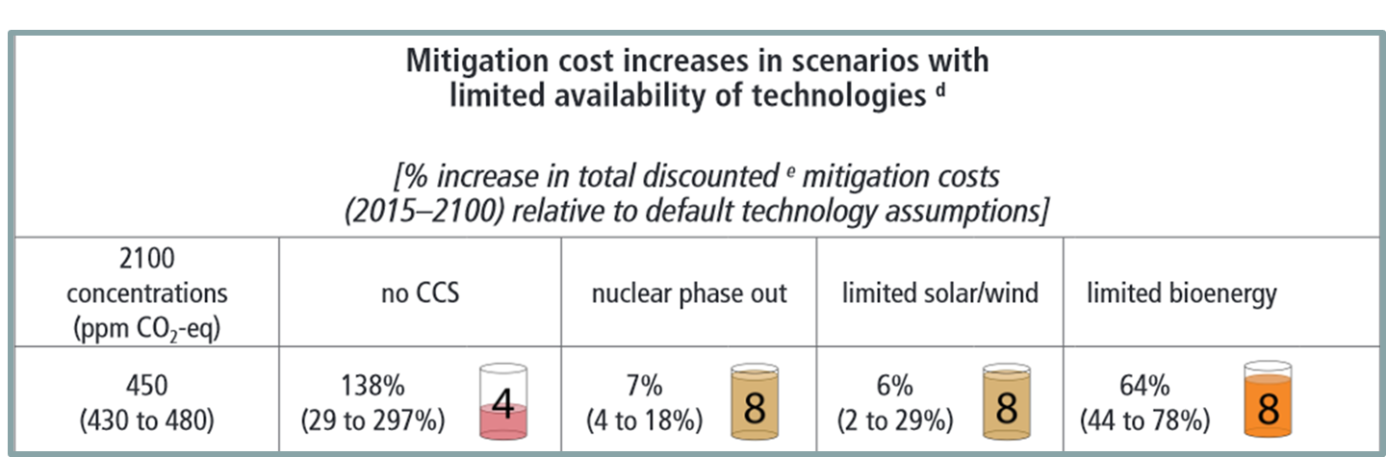
IPCC AR5 – Role of different low-carbon energy technologies
IPCC AR5 SYR from Table 3.2 (2014)

Slide 3
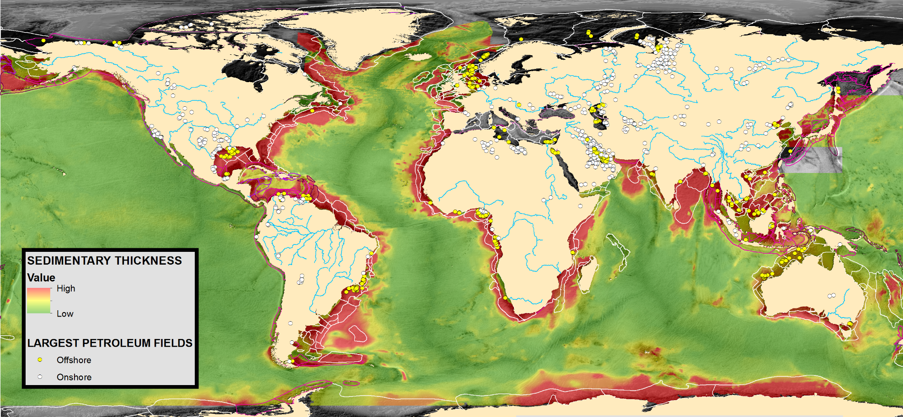
Offshore Potential
The global offshore continental shelves represent the largest near-term storage for Gigaton-scale CCS.

Slide 4

CSLF Report on Offshore
Geologic CO2 Storage
“There is a growing wealth of research, development and practical experiences that are relevant to CO₂ storage offshore, but this expertise is familiar only to a few specific countries around the world. However there is also significant global potential for offshore CO₂ storage, and countries who are not yet active but may become interested in offshore storage, would benefit from knowledge sharing from these existing experiences and expertise. Such international knowledge sharing would be facilitated by international workshops and by international collaborative projects.”
(CSLF Ministerial Nov 2015: CSLF-T-2015-06)

Slide 5
1st Workshop
Aim: To initiate a discussion about the various aspects of offshore transport and storage to build an international community of parties interested in ‘how to do’ offshore storage.
Objectives:
To facilitate countries to understand what is required, to share best practice and learnings from experiences
To identify their specific issues, challenges, opportunities, etc.
To identify synergies, common gaps and goals, and to recommend actions and next steps and opportunities for project collaboration

Slide 6
1st WORKSHOP
Organised by the Bureau of Economic Geology (BEG) at The University of Texas at Austin in collaboration with the South African Centre for CCS at SANEDI, IEAGHG and with support from CSLF and UNFCCC’s CTCN
To facilitate sharing of knowledge and experiences among those who are doing offshore storage and those who may be interested
19-21 April 2016, at the BEG, University of Texas, Austin
13 countries attended (7 developing countries)

Slide 7
Experts who ‘do’ offshore
Norway
  New work on storage assessments and shipping
  Subsea engineering
Netherlands – K12B and shipping
Brazil – offshore deepwater EOR
Japan – Tomakomai
UK – Risk management for Goldeneye

Slide 8
Those on the path to ‘doing’
Status and Needs
25 responses to survey
10 presentations:
    South Africa
    China
    USA
    Nigeria
    Ghana
    Korea
    Mexico
    Australia
    SE Asia CCOP initiative
    CGS Baltic project

Slide 9
Additional information needed to progress toward CCS decision? Storage

Slide 10
Conclusions
Each country is at a different place on the path to offshore CCS, but with common interests
Benefits of existing oil and gas infrastructure
Environmental Impacts and Monitoring: the more we study, the more we learn, the greater the reassurance and confidence

Slide 11
Recommendations
Workshop/training - Technical “deep dive” offshore storage
Workshop/Task Force on infrastructure – assessment, new vs re-use, technology developments, shipping vs pipelines
Workshop/training on storage resource assessment
Workshop on funding tools/sources for early stages of CCS resource assessment in Developing Countries
International collaboration and funding mechanism for demo project (like IODP)
Develop infrastructure test programme/pilot project

Slide 12
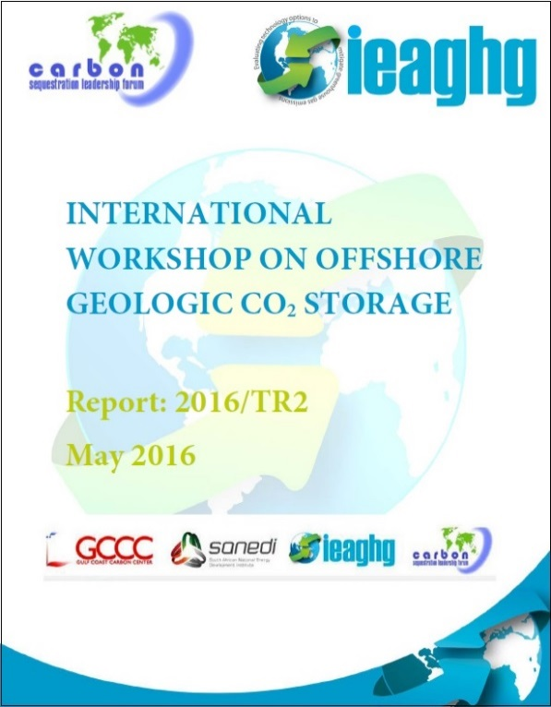
Presentations available http://www.beg.utexas.edu/gccc/goi.php

Slide 13
2nd Workshop
Aim: To address and build on the recommendations and topics raised at the first workshop to take offshore storage forward. Continuing theme of ‘how to do’.
Objectives: Technical ‘deeper-dive’ into key topics:
How to find storage offshore;
Technical aspects and experiences of offshore monitoring;
CO2-EOR offshore;
Infrastructure developments and decisions
U.S. developments in offshore storage assessment
Conclusions and recommendations
Field Trip

Slide 14
Goals, expectations, logistics
2nd International Workshop
Katherine Romanak, Tip Meckel (Gulf Coast Carbon Center) and
Tim Dixon (IEAGHG and BEG Honorary Senior Research Fellow)
19-20 June, 2017
Lamar University
Beaumont, Texas, USA

Slide 15
Conclusions

Slide 16
Recommendations

Slide 17
Steering Committee
Tim Dixon, IEAGHG (Chair)
Katherine Romanak, BEG (Co-Chair, Host)
Susan Hovorka, BEG (Host)
Tip Meckel, BEG (Host)
Anthony Surridge / Noel Kamrajh, SANEDI (host)
John Litynski / Traci Rodosta, US DOE
Lars Ingolf Eide, Research Council of Norway
Di Zhou, China Academy of Sciences
Filip Neele, TNO
Paulo Negrais Seabra- Independent Consultant (formerly Petrobras)
Ryozo Tanaka, RITE
Owain Tucker, Shell
Philip Ringrose, Statoil
Michael Carpenter, Gassnova
Paul Latiolais, Lamar University
Thanks to Jennifer Edwards (BEG) and Thonda Harvey (Lamar)

Slide 18
Goals, expectations, logistics
2nd International Workshop
Katherine Romanak, Tip Meckel (Gulf Coast Carbon Center) and
Tim Dixon (IEAGHG and BEG Honorary Senior Research Fellow)
19-20 June, 2017
Lamar University
Beaumont, Texas, USA

